Slide 1
2014 Veterinary Science CDE
Identification and Practicum Resource

Slide 2
222. Liver Fluke

Slide 3
209. Flea Tapeworm

Slide 4
203. Cattle Grub

Slide 5
212. Giardia

Slide 6
202. Cat Warble

Slide 7
224. Mosquito Adult

Slide 8
233. Whipworm

Slide 9
223. Lungworm

Slide 10
230. Taenia Tapeworm

Slide 11
229. Sarcoptic Mite

Slide 12
218. Horse Bots

Slide 13
213. Hard Tick

Slide 14
207. Fleas

Slide 15
206. Ear Mite

Slide 16
200. Blowfly

Slide 17
008. Persian Cat

Slide 18
049. Gecko

Slide 19
009. Ragdoll Cat

Slide 20
040. Chinchilla

Slide 21
047. Sugar Glider

Slide 22
007. Manx Cat

Slide 23
046. Hedgehog

Slide 24
013. Turkish Angora Cat

Slide 25
026. Mini Rex Rabbit

Slide 26
031. Parakeet

Slide 27
129. IV Butterfly Catheter

Slide 28
149. Hog Snare

Slide 29
119. Tattoo Outfit: Manual

Slide 30
121. Halter

Slide 31
117. Ear Notcher

Slide 32
168. Mayo-Hegar Needle Holder

Slide 33
102. Balling Gun

Slide 34
164. Scalpel Handles

Slide 35
125. Barnes dehorner

Slide 36
118. ID Tag Applicator

Slide 37
114. Animal Clippers

Slide 38
154. Elizabethan Collar

Slide 39
142. Hoof Rasp

Slide 40
133. Elastrator

Slide 41
137. Obstetrical Chain

Slide 42
151. Feline Restraint Bag

Slide 43
140. Hoof Nipper

Slide 44
143. Lead Rope

Slide 45
165. Scalpel Blades

Slide 46
115. Clipper Blades

Slide 47
100. Disposable Syringe

Slide 48
150. Pig Tooth Nipper

Slide 49
172. Lister Bandage Scissors

Slide 50
120. Rope Halter

Slide 51
101. Automatic Dose Syringe

Slide 52
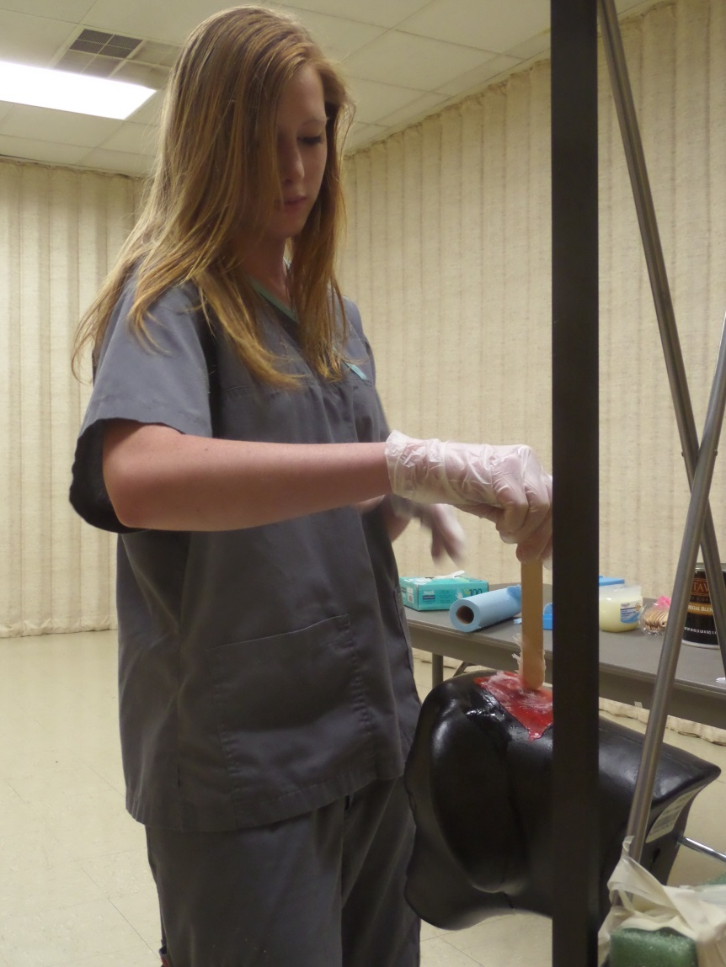
Applying a Topical Wound Treatment Practicum

Slide 53
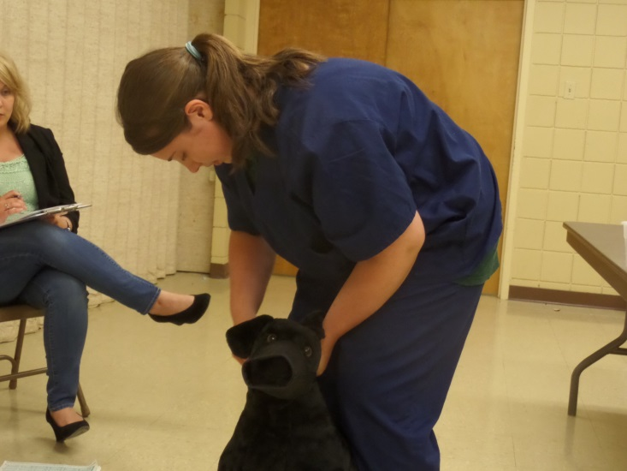
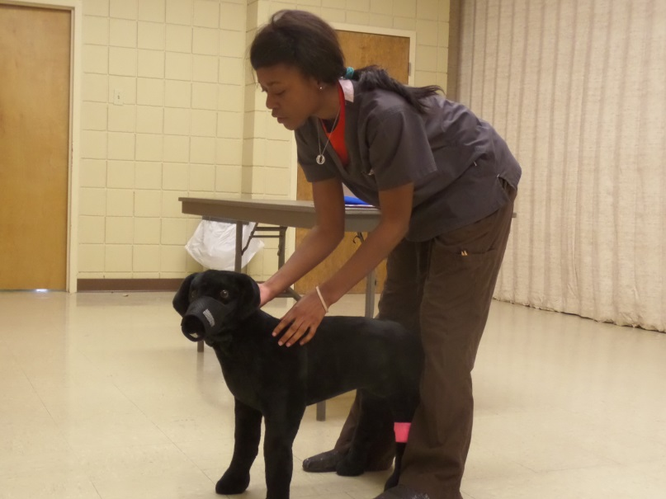
Applying a Commercial Dog Muzzle Practicum

Slide 54
Restraint of the Cat for Cephalic IV Catheter Placement Practicum

Slide 55
Filling a Syringe Practicum

